Slide 1
Stream networks and H/L ratio: more details

Slide 2
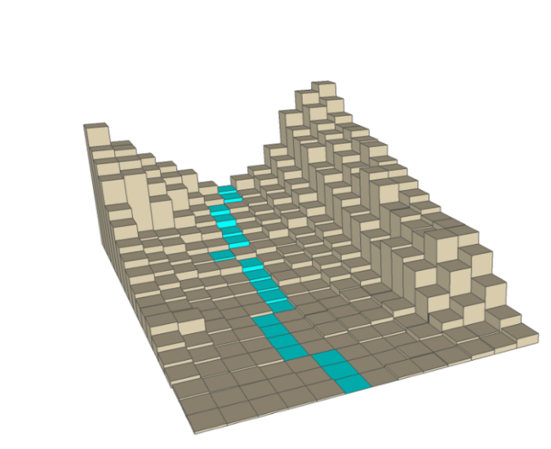

Stream Network
“Create surface hydrology rasters” and “Generate Stream Network” tools in ArcGIS LAHARZ, the “r.stream.extract” in QGIS, or the newest version of the standalone Python LAHARZ generates stream network using the DEM, and a user defined stream threshold
This is the number of upstream cells that have to flow into a cell to consider it a stream cell. A smaller number here will make a stream network with more branches and longer streams, a higher number creates a simpler stream network with fewer branches
The network should generally match published maps, but should represent the *current* stream network

Slide 3
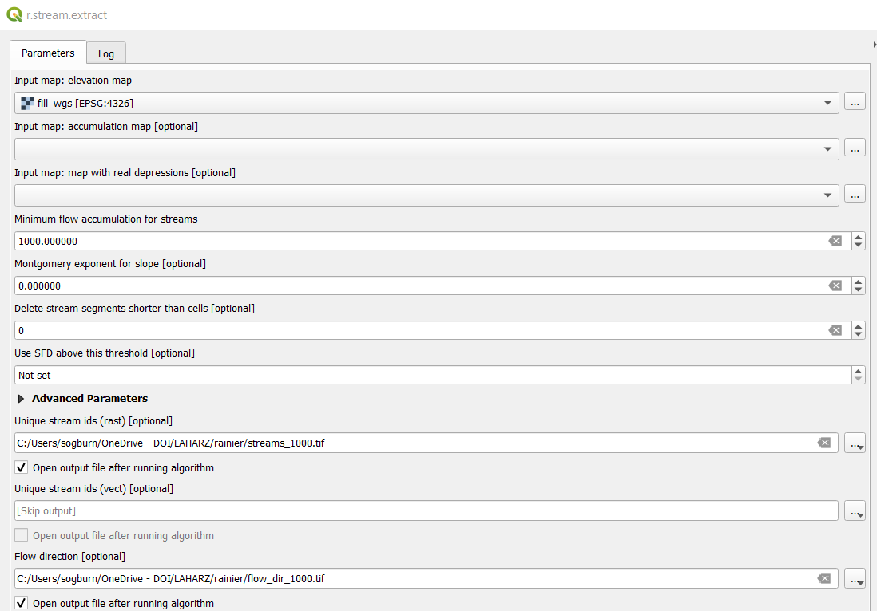
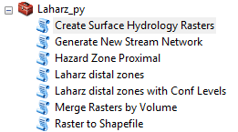
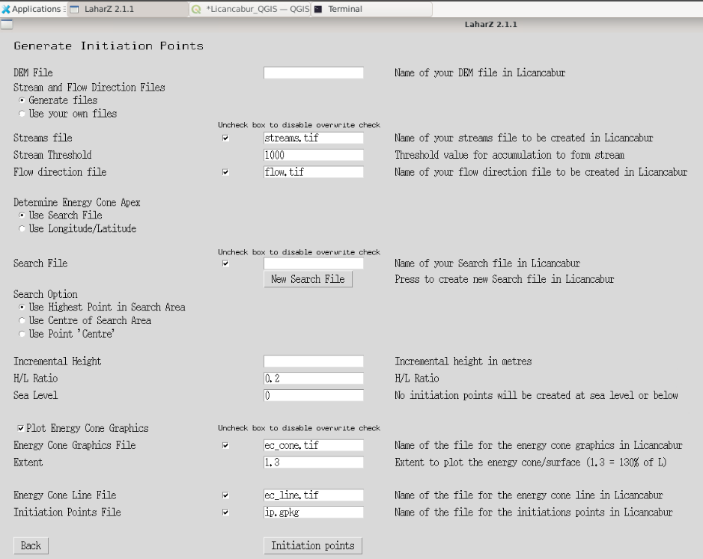
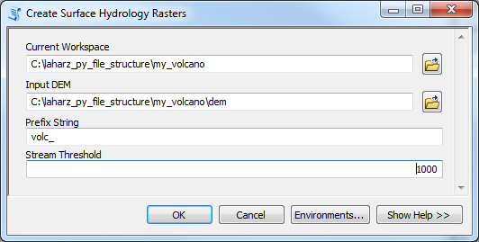

Slide 4
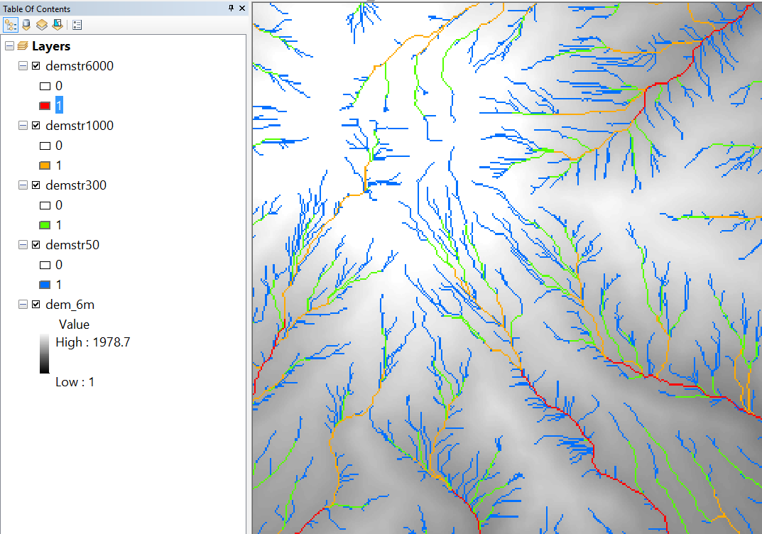
High stream threshold: shorter stream network with fewer branches
Low stream threshold: longer stream network with more branches

Slide 5
78 | 72 | 69 | 71 | 58 | 49
74 | 67 | 56 | 49 | 46 | 50
69 | 53 | 44 | 37 | 38 | 48
64 | 58 | 55 | 22 | 31 | 24
68 | 61 | 47 | 21 | 16 | 19
74 | 53 | 34 | 12 | 11 | 12
Elevation (DEM)

Slide 6
78 | 72 | 69 | 71 | 58 | 49
74 | 67 | 56 | 49 | 46 | 50
69 | 53 | 44 | 37 | 38 | 48
64 | 58 | 55 | 22 | 31 | 24
68 | 61 | 47 | 21 | 16 | 19
74 | 53 | 34 | 12 | 11 | 12
Elevation→Flow direction
Where would a drop of water that fell on the yellow square go?
Elevation (DEM)

Slide 7
78 | 72 | 69 | 71 | 58 | 49
74 | 67 | 56 | 49 | 46 | 50
69 | 53 | 44 | 37 | 38 | 48
64 | 58 | 55 | 22 | 31 | 24
68 | 61 | 47 | 21 | 16 | 19
74 | 53 | 34 | 12 | 11 | 12
↘ | ↘ | ↘ | ↓ | ↓ | ↙
↘ | ↘ | ↘ | ↓ | ↓ | ↙
→ | → | ↘ | ↓ | ↙ | ↓
↗ | ↗ | → | ↘ | ↓ | ↙
↘ | ↘ | → | ↓ | ↓ | ↓
→ | → | → | → | ↓ | ←
Elevation (DEM)
Flow direction

Slide 8
↘ | ↘ | ↘ | ↓ | ↓ | ↙
↘ | ↘ | ↘ | ↓ | ↓ | ↙
→ | → | ↘ | ↓ | ↙ | ↓
↗ | ↗ | → | ↘ | ↓ | ↙
↘ | ↘ | → | ↓ | ↓ | ↓
→ | → | → | → | ↓ | ←
Flow direction → Flow accumulation
How many cells flow into the yellow square?
Flow direction

Slide 9
↘ | ↘ | ↘ | ↓ | ↓ | ↙
↘ | ↘ | ↘ | ↓ | ↓ | ↙
→ | → | ↘ | ↓ | ↙ | ↓
↗ | ↗ | → | ↘ | ↓ | ↙
↘ | ↘ | → | ↓ | ↓ | ↓
→ | → | → | → | ↓ | ←
0 | 0 | 0 | 0 | 0 | 0
0 | 1 | 1 | 2 | 2 | 0
0 | 3 | 7 | 5 | 4 | 0
0 | 0 | 0 | 20 | 0 | 1
0 | 0 | 0 | 1 | 24 | 0
0 | 2 | 4 | 7 | 35 | 1
Flow direction
Flow accumulation

Slide 10
0 | 0 | 0 | 0 | 0 | 0
0 | 1 | 1 | 2 | 2 | 0
0 | 3 | 7 | 5 | 4 | 0
0 | 0 | 0 | 20 | 0 | 1
0 | 0 | 0 | 1 | 24 | 0
0 | 2 | 4 | 7 | 35 | 1
Flow accumulation → Stream network
With a stream threshold of 2 what does the stream network look like?
Flow accumulation
Stream threshold = 2

Slide 11
0 | 0 | 0 | 0 | 0 | 0
0 | 1 | 1 | 2 | 2 | 0
0 | 3 | 7 | 5 | 4 | 0
0 | 0 | 0 | 20 | 0 | 1
0 | 0 | 0 | 1 | 24 | 0
0 | 2 | 4 | 7 | 35 | 1
Stream threshold = 2

Slide 12
0 | 0 | 0 | 0 | 0 | 0
0 | 1 | 1 | 2 | 2 | 0
0 | 3 | 7 | 5 | 4 | 0
0 | 0 | 0 | 20 | 0 | 1
0 | 0 | 0 | 1 | 24 | 0
0 | 2 | 4 | 7 | 35 | 1
Flow accumulation → Stream network
With a stream threshold of 6 what does the stream network look like?
Flow accumulation
Stream threshold = 6

Slide 13
0 | 0 | 0 | 0 | 0 | 0
0 | 1 | 1 | 2 | 2 | 0
0 | 3 | 7 | 5 | 4 | 0
0 | 0 | 0 | 20 | 0 | 1
0 | 0 | 0 | 1 | 24 | 0
0 | 2 | 4 | 7 | 35 | 1
Stream threshold = 6

Slide 14
78 | 72 | 69 | 71 | 58 | 49
74 | 67 | 56 | 49 | 46 | 50
69 | 53 | 44 | 37 | 38 | 48
64 | 58 | 55 | 22 | 31 | 24
68 | 61 | 47 | 21 | 16 | 19
74 | 53 | 34 | 12 | 11 | 12
↘ | ↘ | ↘ | ↓ | ↓ | ↙
↘ | ↘ | ↘ | ↓ | ↓ | ↙
→ | → | ↘ | ↓ | ↙ | ↓
↗ | ↗ | → | ↘ | ↓ | ↙
↘ | ↘ | → | ↓ | ↓ | ↓
→ | → | → | → | ↓ | ←
0 | 0 | 0 | 0 | 0 | 0
0 | 1 | 1 | 2 | 2 | 0
0 | 3 | 7 | 5 | 4 | 0
0 | 0 | 0 | 20 | 0 | 1
0 | 0 | 0 | 1 | 24 | 0
0 | 2 | 4 | 7 | 35 | 1
Elevation (DEM)
Flow direction
Flow accumulation
0 | 0 | 0 | 0 | 0 | 0
0 | 1 | 1 | 2 | 2 | 0
0 | 3 | 7 | 5 | 4 | 0
0 | 0 | 0 | 20 | 0 | 1
0 | 0 | 0 | 1 | 24 | 0
0 | 2 | 4 | 7 | 35 | 1
0 | 0 | 0 | 0 | 0 | 0
0 | 1 | 1 | 2 | 2 | 0
0 | 3 | 7 | 5 | 4 | 0
0 | 0 | 0 | 20 | 0 | 1
0 | 0 | 0 | 1 | 24 | 0
0 | 2 | 4 | 7 | 35 | 1
Lower stream threshold: longer stream network with more branches
Higher stream threshold: shorter stream network with fewer branches
Stream threshold = 2
Stream threshold = 6

Slide 15
Lower stream threshold: longer stream network with more branches
Higher stream threshold: shorter stream network with fewer branches

Slide 16
How to decide on the stream threshold
Compare your stream network to a recent topographic map
Compare your stream network to a recent satellite image
Compare your stream network to field measurements
Examine the stream network in locations where lahars/flash floods have been known to spill over into other channels

Slide 17
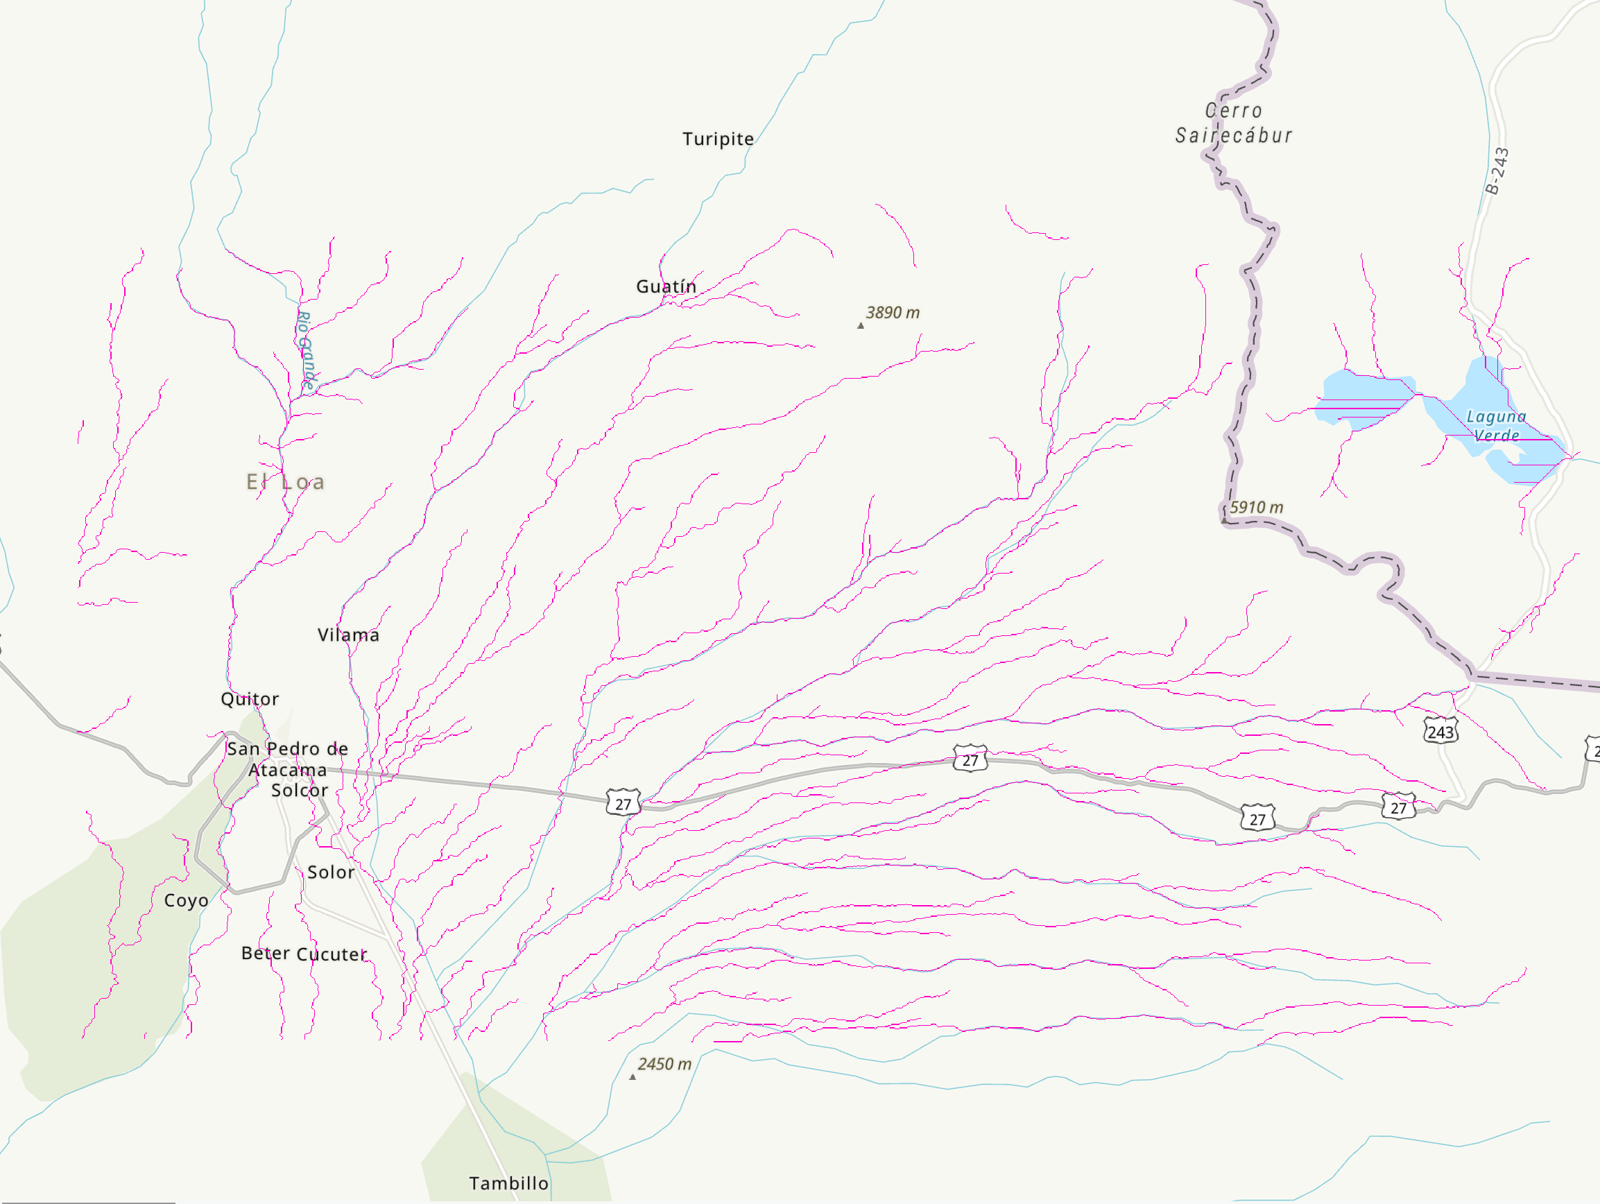
Evaluate the computer-generated streams to a basemap or (better) an authoritative map made locally and recently.
Reasons why there may be differences:
Landscapes change over time, seasonally or catastrophically
Man-made features like paving, canals, dams or bridges may alter the topography
Map made at the wrong scale to be accurate at this local- regional scale
DEM may be older and may not reflect changes
Errors
Your hazard map (output) will only ever be as good as the DEM and streams (input) you give the program

Slide 18
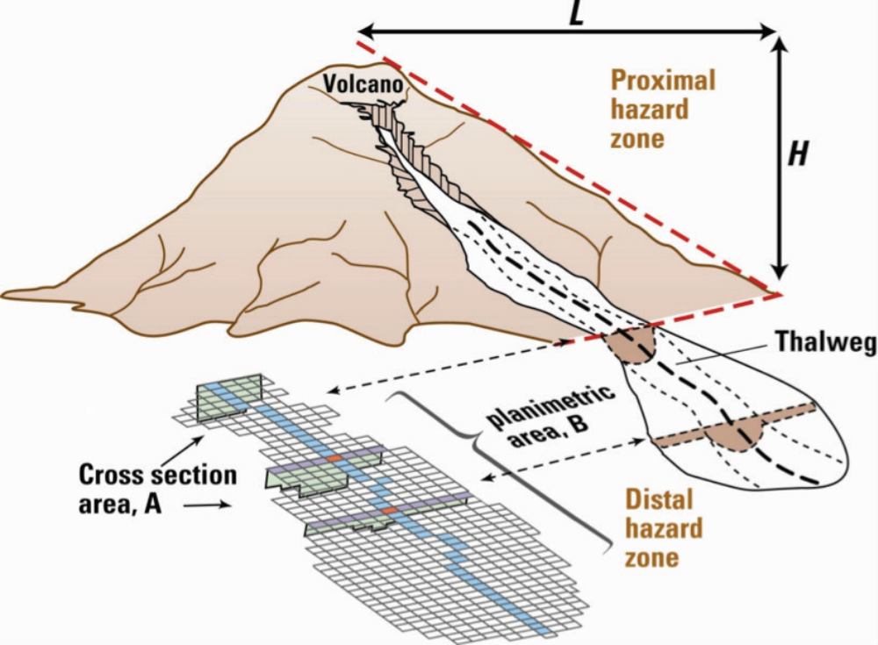
H/L or energy cones

Slide 19
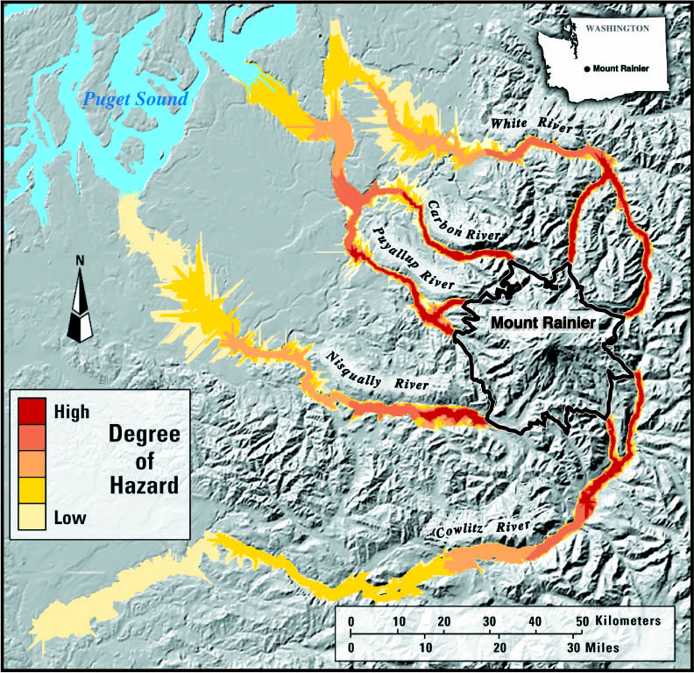
On a hazard map, the Proximal Hazard Zone, or highest hazard zone, is the most hazardous, most destructive area around a volcano because of steep slopes and proximity to the summit.
Proximal hazard zones usually include pyroclastic flows, volcanic bombs, vent lava flows and tephra fall.
For LAHARZ, creating a proximal hazard zone is also a convenient way to determine start locations for modeling lahars.

Slide 20
H/L = LAHARZ slope value, energy cone,
coefficient of friction, Heim coefficient, H/L ratio

Slide 21
Lahar hazard zones computed for Mt. Rainier with proximal
hazard zone defined by H/L = 0.23

Slide 22
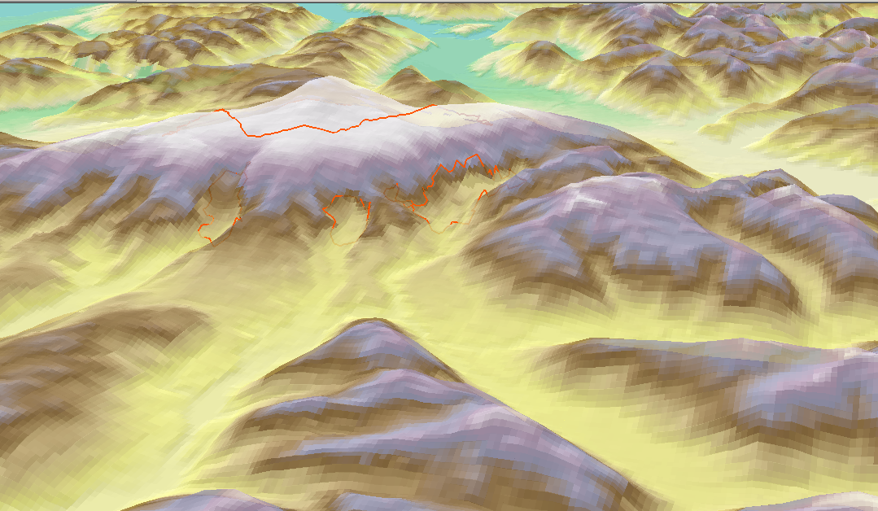
Length (L)
H/L=0.23
Height (H)

Slide 23
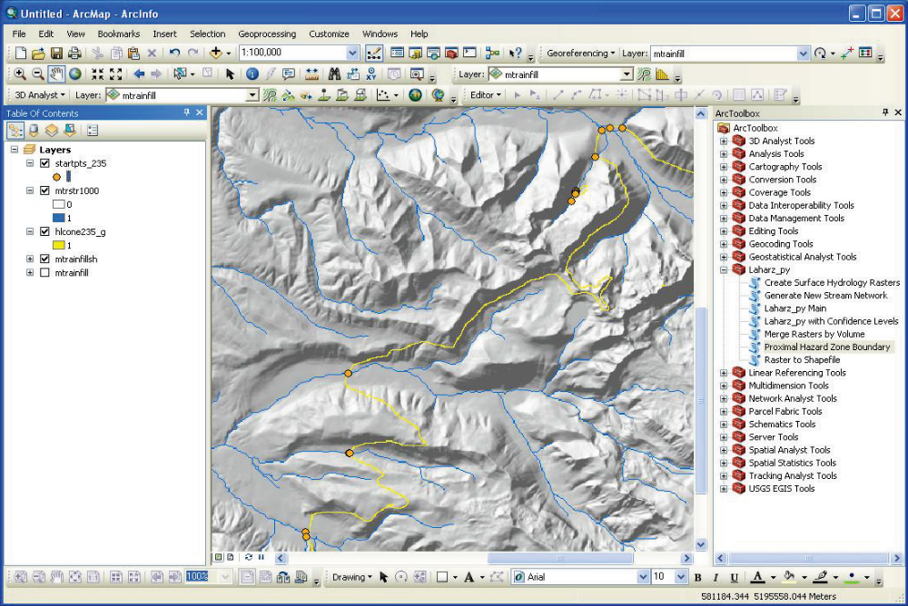

Slide 24
Lahar hazard zones computed for Mt. Rainier with proximal
hazard zone defined by H/L = 0.23

Slide 25
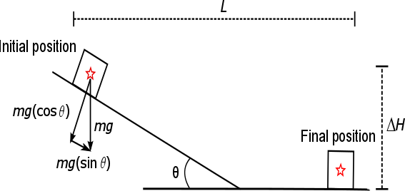
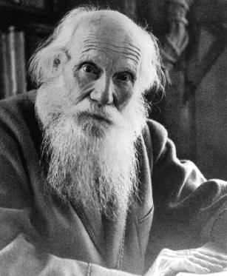
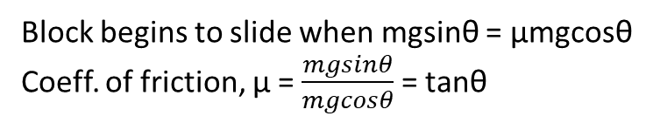
Block begins to slide when mgsinθ = μmgcosθ
Coeff. of friction, μ = $\frac{mgsinθ}{mgcosθ}$ = tanθ
Heim (1932) considered the Fahrböschung, or the angle of reach of a debris avalanche, to be an energy line which describes the rate of kinetic energy loss by friction. Shreve (1968) and Scheidegger (1973) interpreted H/L as an equivalent coefficient of friction following a Mohr-Coulomb friction model, in which shear stress at the initiation of failure is proportional to the normal stress, can be approximated by a block sliding down a plane.
Heim, 1932

Slide 26
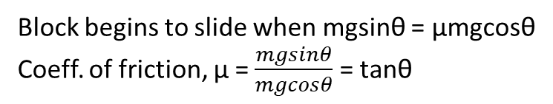
H/L or
Heim coefficient
Height dropped/runout length
Block begins to slide when gravitational force down a plane equals the frictional force
Tanθ =coeff. of friction, μ = H/L = Heim coefficient
Block begins to slide when mgsinθ = μmgcosθ
Coeff. of friction, μ = $\frac{mgsinθ}{mgcosθ}$ = tanθ

Slide 27
Relationship between PDC volume and H/L is frequently used in energy cone modeling of PDCs
(we’ll talk about this more later!)
4 ∆H/L energy cones
(for 0.0001 to 0.1 km³)

Slide 28
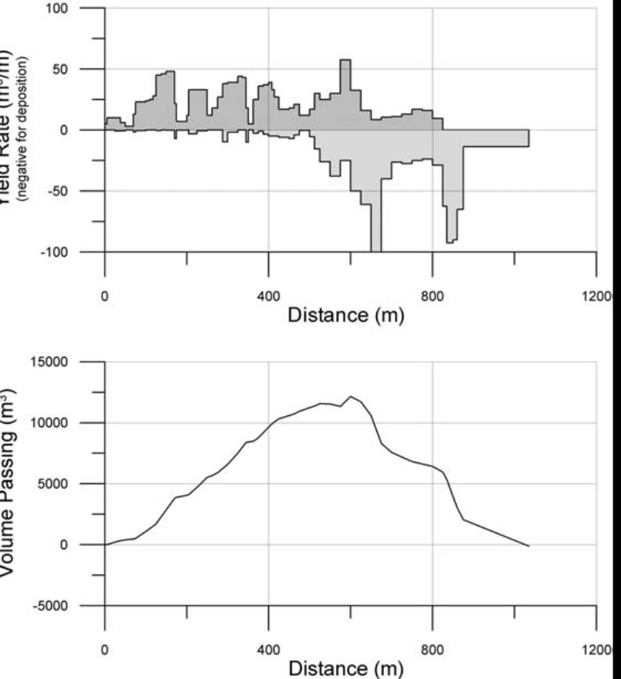
Proximal Hazard Zone for LAHARZ
Why use H/L Cone for lahars?
Lahars may initiate anywhere on the volcano edifice. We can’t know an exact start location in advance.
Loose pyroclastic flow deposits and ashfall are often the source material for lahars and are most abundant within the H/L cone.
Lahars gain volume (entrain material) on steep slopes.
Lahar Mass Balance Analysis
Volume peaks and declines
Volume
net erosion
net deposition
So, we start modeling lahars by estimating where on the flanks the flow volume is greatest.
We do this by defining an H/L cone that marks the transition between erosion and deposition. That is, inside the H/L cone, the volume is still increasing. Outside the H/L cone, the volume is maintained or decreasing (depositing).
How do we identify an H/L cone that represents this transition?
  from net erosion to net deposition
  from steep slopes to moderate slopes (20°-30°), that is, find the break in slope
  from pyroclastic debris fans to more channelized flows

Slide 29
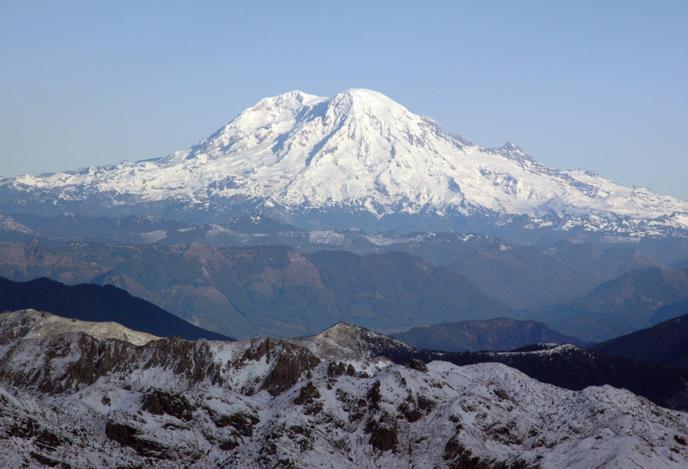
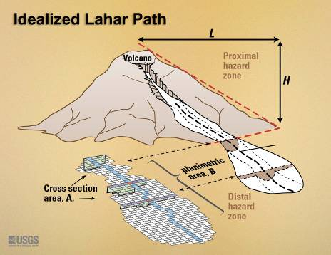
Mt. Rainier, west side
L
V
H
Begin flow hazard-zone computation where
deposition first exceeds erosion

Slide 30
Okay, so how do we choose the H/L value?
PDC deposit fans are useful for choosing an H/L cone/proximal hazard zone
Visualize volcano in 3-D:
  Find photos (Google image search, GVP)
  Use Google Earth to get oblique views, fly around, and make a topographic profile.
Examine volcano records of past events:
  geologic maps; observatory logs; GVP info
Look at the geomorphology:
  landforms, farming, land use
Look for PDC units in the field
Examine satellite imagery
Use global record of analog volcanoes (PDC H/L values)
Start with H/L of 0.3 and refine

Slide 31
Okay, so how do we choose the H/L value?
PDC deposit fans are useful for choosing an ∆H/L cone/proximal hazard zone
Visualize volcano in 3-D:
  Find photos (Google image search, GVP)
  Use Google Earth to get oblique views, fly around, and make a topographic profile.
Examine volcano records of past events:
  geologic maps; observatory logs; GVP info
Look at the geomorphology:
  landforms, farming, land use
Look for PDC units in the field
Examine satellite imagery
Use global record of analog volcanoes (PDC H/L values)
Start with H/L of 0.3 and refine

Slide 32
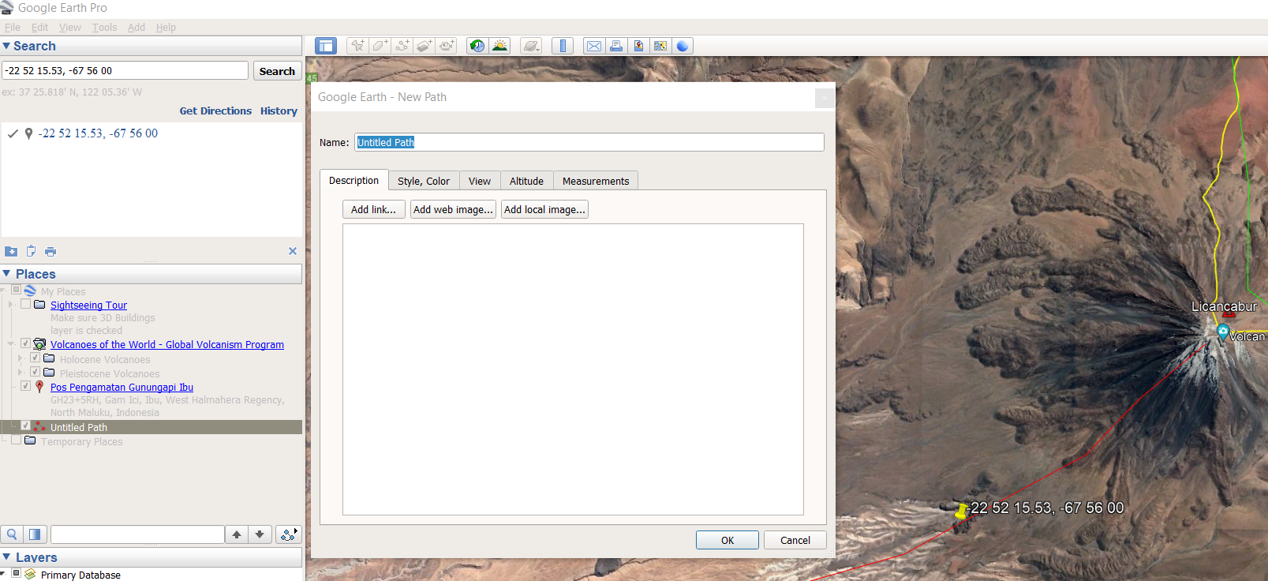
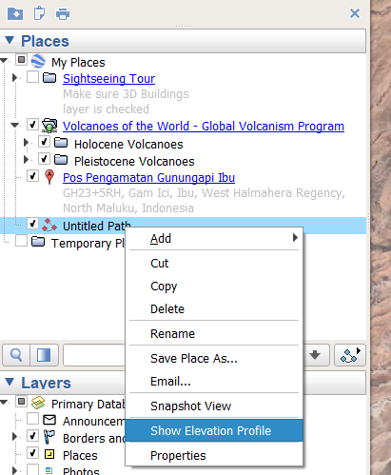
Visualize volcano in 3-D
Click on the “Add path” button
Click on the map to make a path
Name and save the path
Right click on the path name under “Places”
Choose “show elevation profile”
Be careful: the slope values given in Google Earth are local, not H/L from the summit

Slide 33
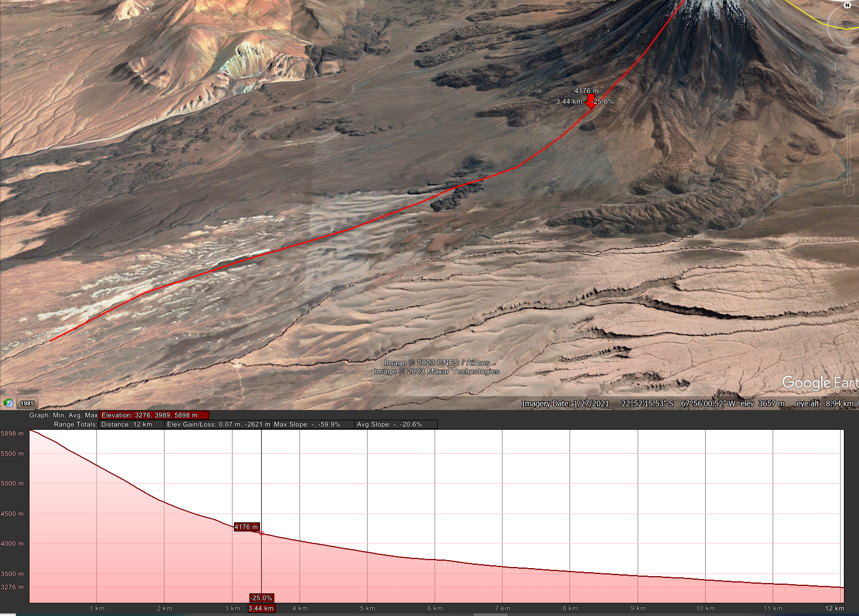
Visualize volcano in 3-D
upper flank=0.6
End of lava flows=0.4
End of most deposit fans=0.3
End of PDCs=0.2
0.4
0.3
0.2
0.6
8 degrees locally
6 degrees locally

Slide 34
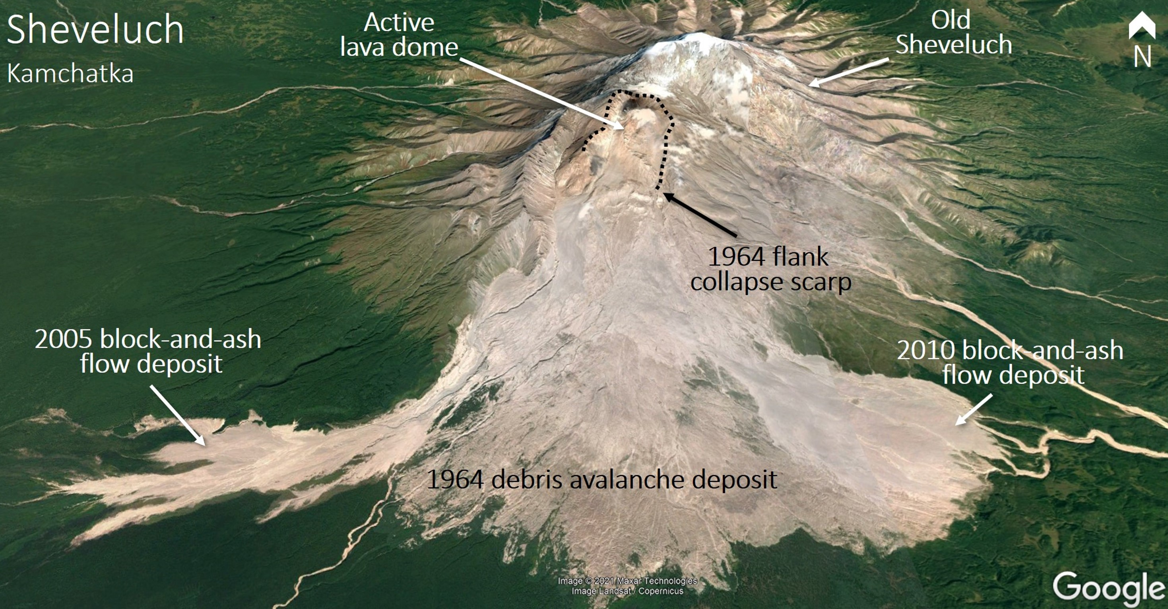
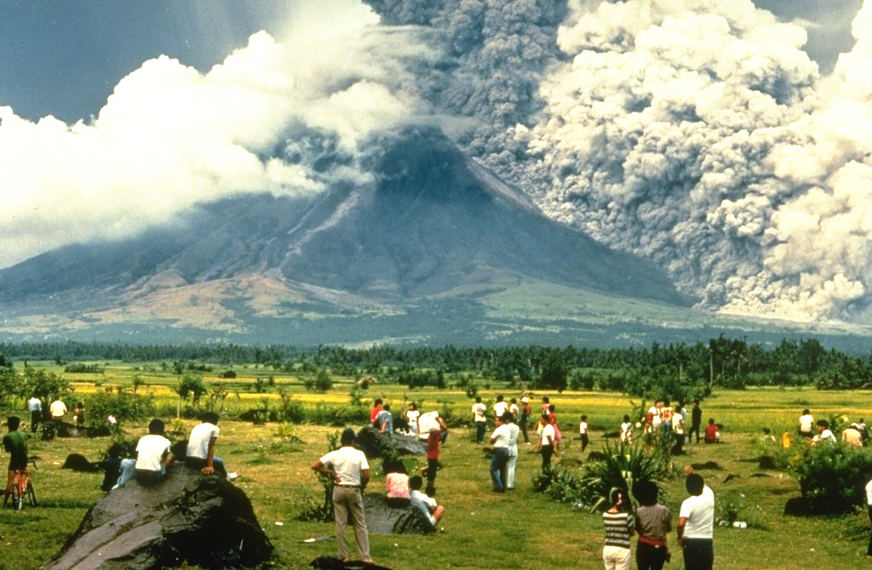
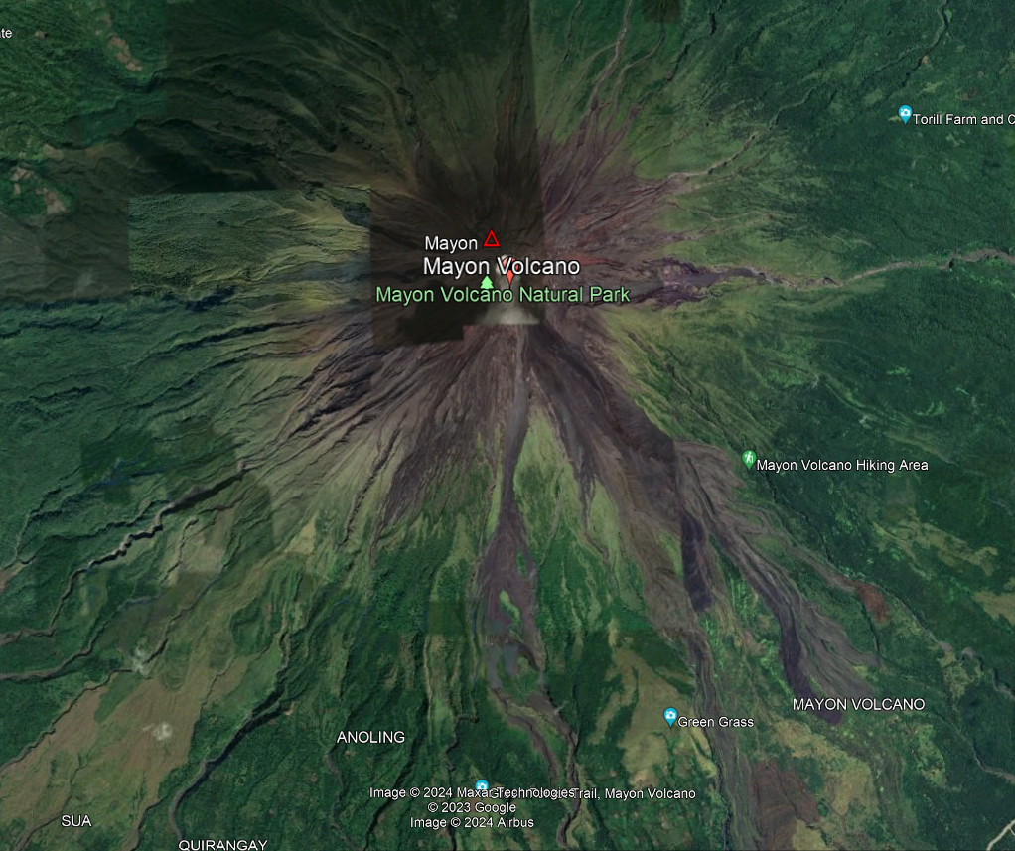
Look for evidence of pyroclastic density currents to help define an H/L ratio
Look at the geomorphology
Examine satellite imagery
Landsat/Copernicus satellite base image courtesy of Google Earth © Maxar Technologies.
Google Search “GVP Mayon”
Google Earth Mayon
Mayon in 1984, USGS photo

Slide 35
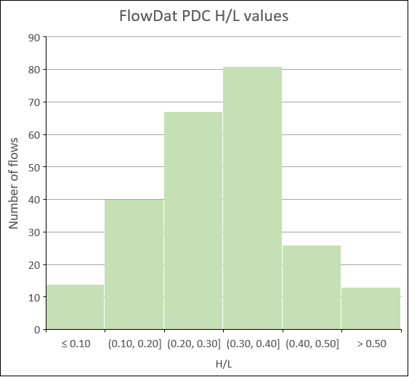
Use global record of analog volcanoes (PDC H/L values)
∆H/L values range from ~0.04 for very large ignimbrites to 0.8 for very small dome-collapses or rockfalls
Mean: 0.30
Median: 0.30
Most (80%) of ∆H/L values fall between 0.15 and 0.44
Start with H/L of 0.3 and refine

Slide 36
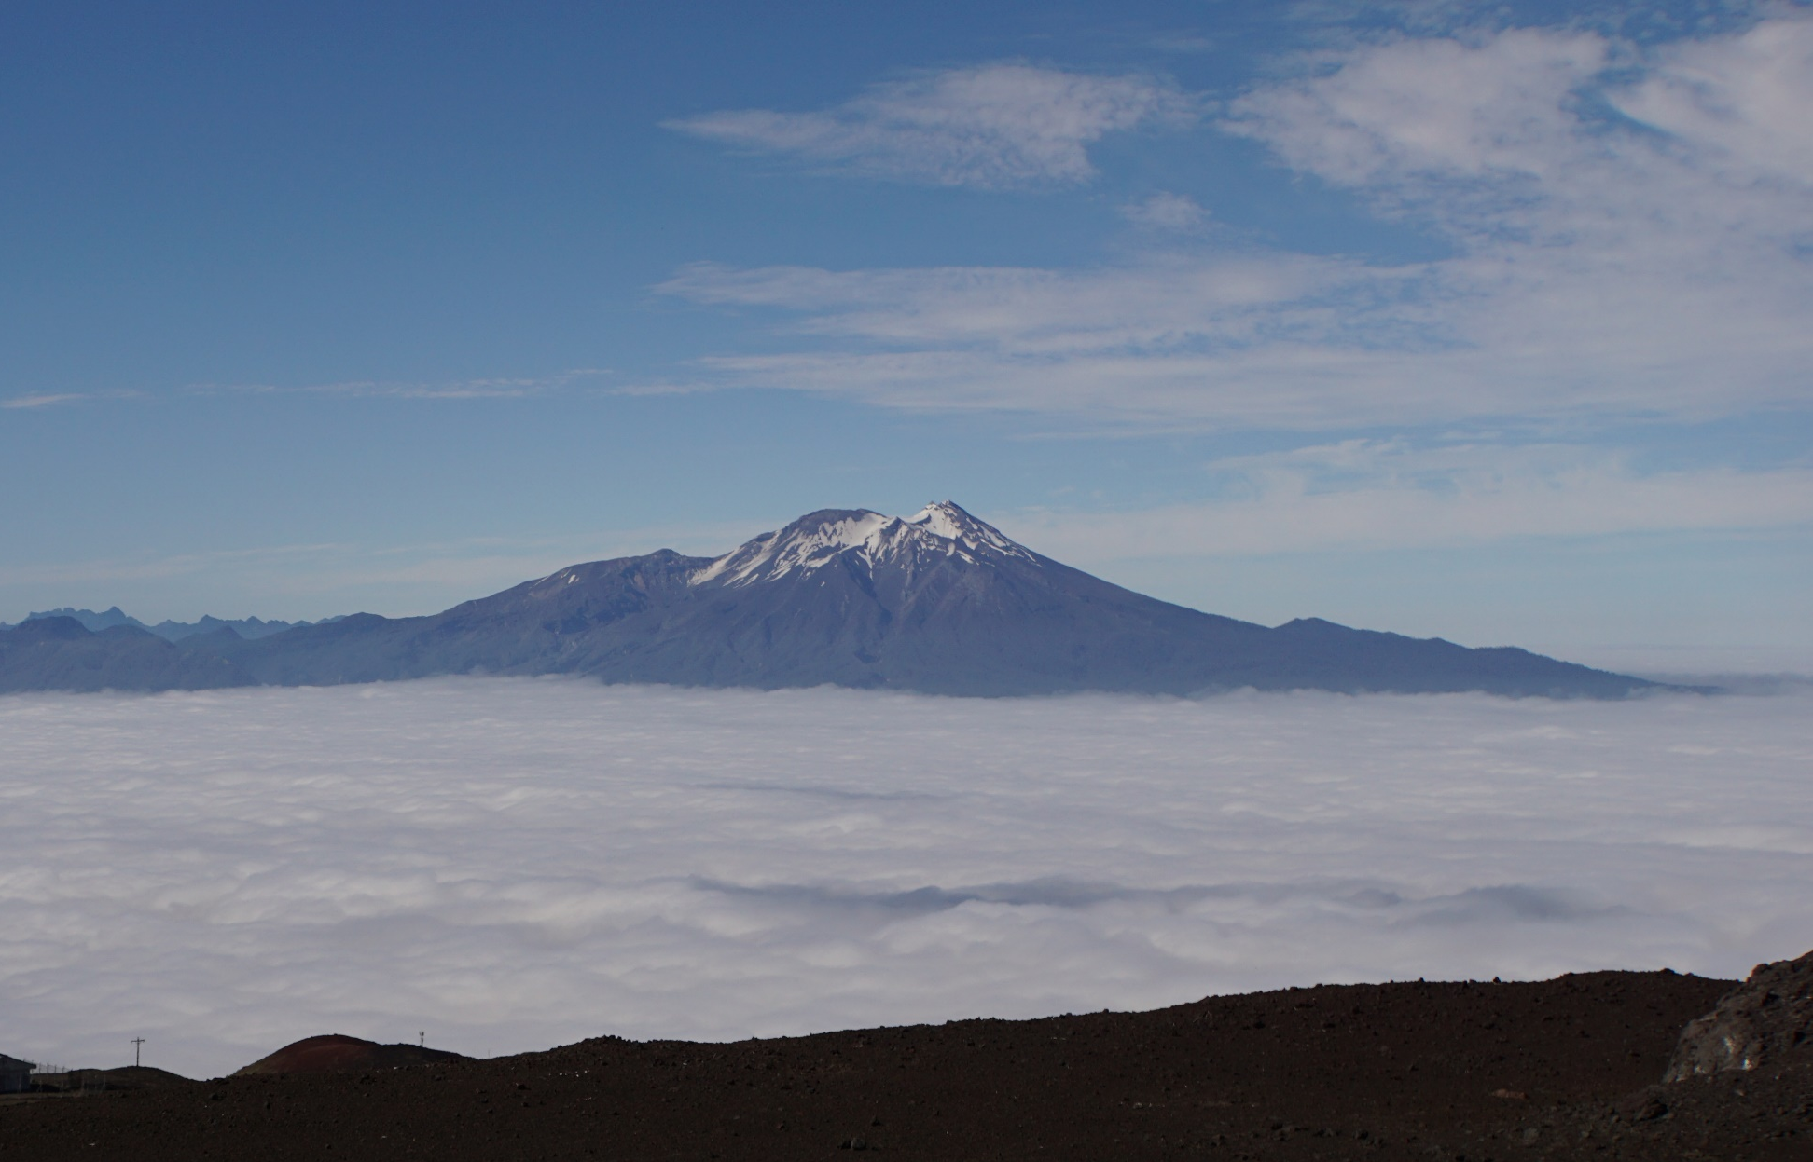
Special Cases: not a nice pointy volcano?

Slide 37
Special Cases: not a nice pointy volcano?
Add elevation in LAHARZ
250 m

Slide 38
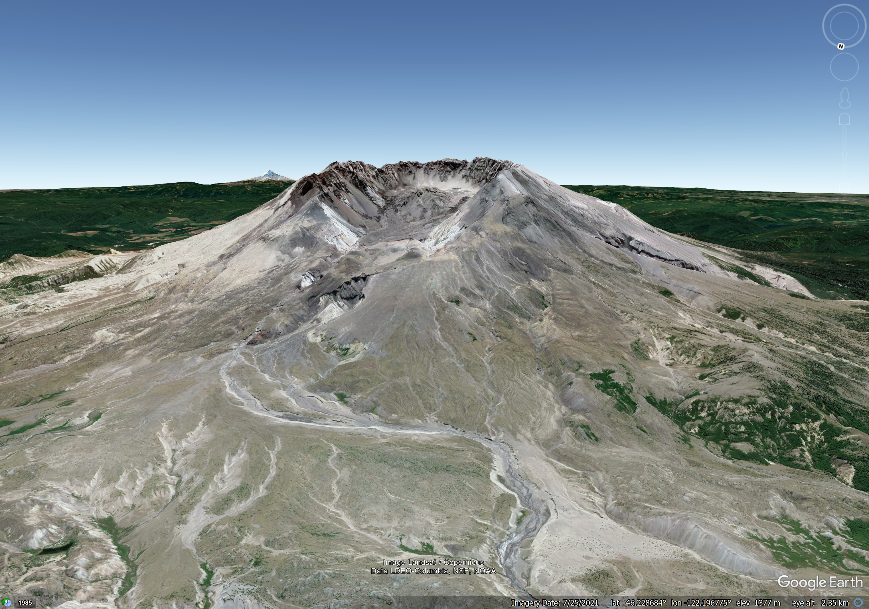
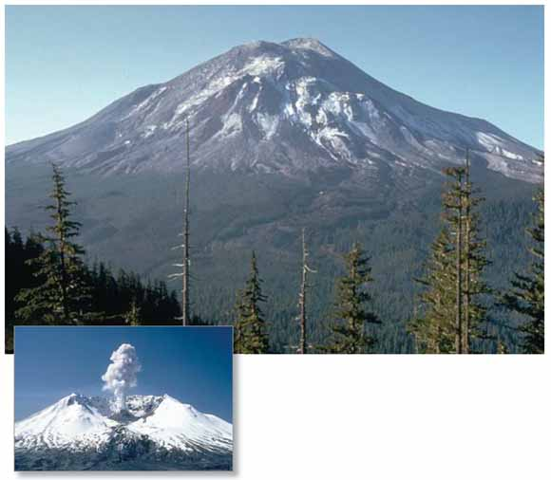
Maximum Elevation of the DEM
2950 meters
2539 meters
along rim
(2004 DEM)
2175 meters top
of dome in 2004
1960 meters crater floor
USGS photos

Slide 39
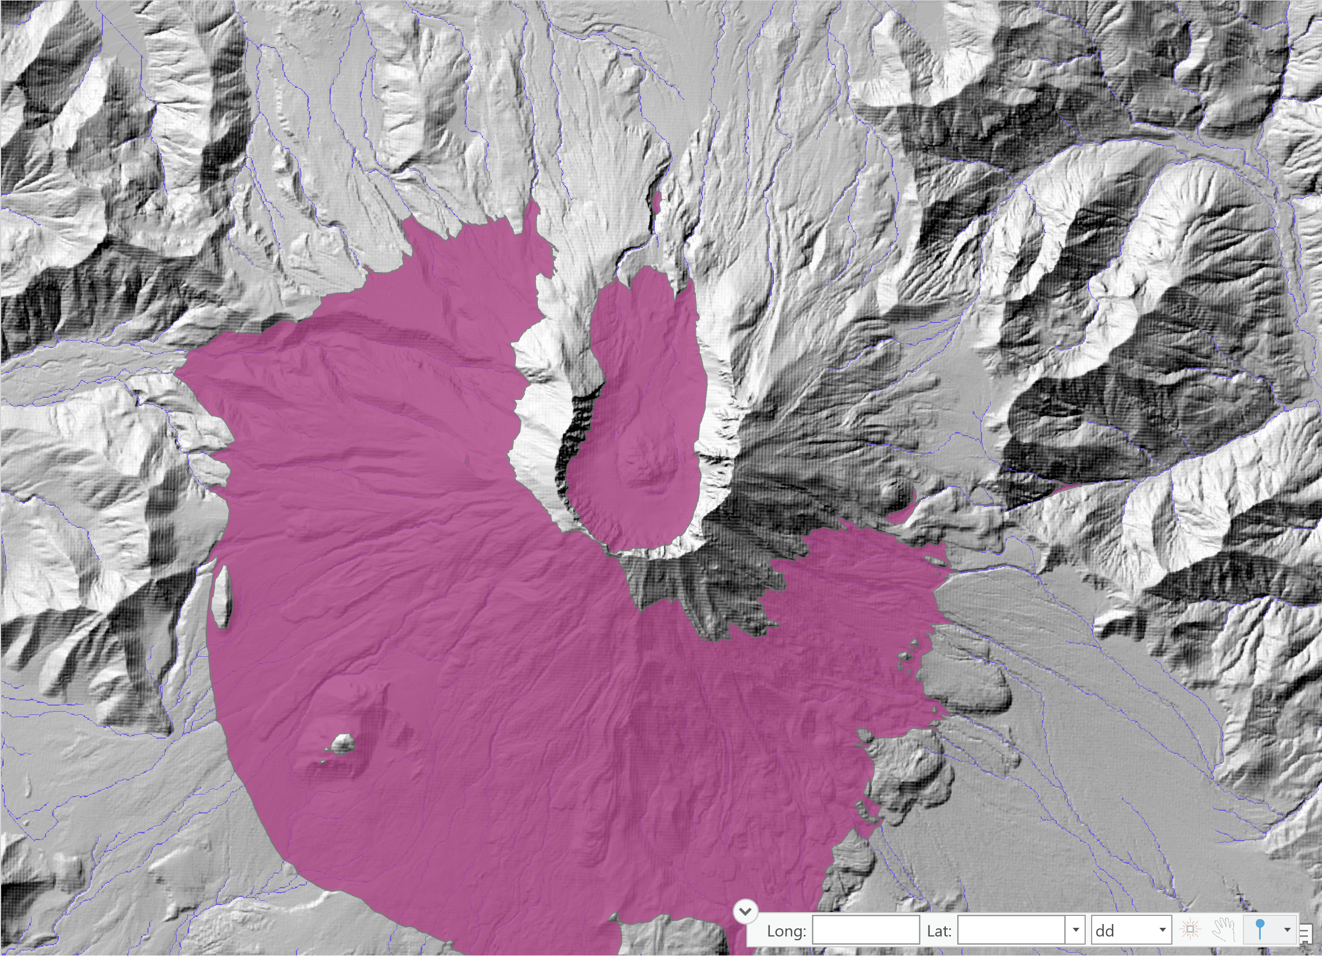
This ∆H/L cone uses the highest point on the DEM, a point on the crater rim. This ∆H/L cone has holes and looks weird!
2539 meters
along rim
(2004 DEM)

Slide 40
To-restablish the summit:
2950 m – 2175 m = add ~800 meters
2950 meters
2539 meters
along rim
(2004 DEM)
2175 meters top
of dome in 2004
1960 meters crater floor
USGS photos

Slide 41
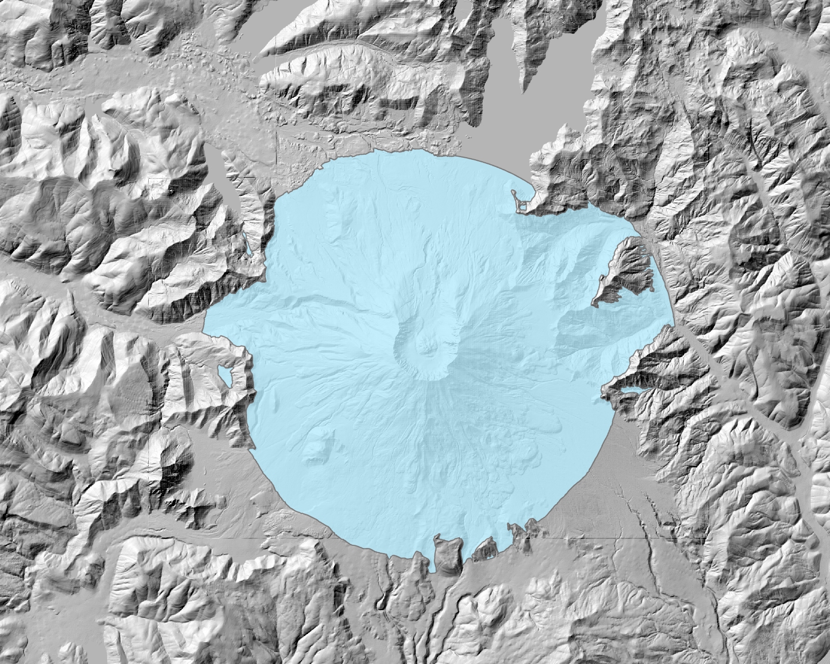
This ∆H/L cone adds ~800 m above the center of the crater. This ∆H/L cone has looks pretty good!

Slide 42
